Slide 1
Thermodynamic Dissection of a Refrigeration Cycle
Nnenna Dara, Sean Hughes, Thomas Zhao
Notes:
Thomas: Introduction slides, Questions 1 and 2
Nnenna: Questions 3 and 4
Sean: Questions 5 and 6

Slide 2
Refrigeration Cycles
Extremely common in the world for obvious reasons
Four types common types of refrigeration cycles being used in the world:
Vapor Compression (Mechanical Compression)
Vapor Absorption
Evaporative Cooling
Thermoelectric Refrigeration
Source: https://www.rsi.edu/blog/hvacr/four-types-refrigeration-systems-need-know/
Notes:
Most common one is vapor compression (is the one we will talk about)
Vapor absorption is similar to vapor compression but the fluids involved are “refrigerants” and “absorbents”
For example, ammonia as refrigerant fluid, water as absorbent
Both vapor compression and vapor absorption depend on the compression and expansion of the refrigerant fluid
Main difference is that rather than relying on electrical work to move, vapor absorption relies on heat absorption to move the refrigerant from high pressure to low pressure and vice versa
Heat can be derived from many fuel sources (natural gas, hot steam, etc.)
Evaporative cooling is pretty nontraditional
They cool warm outdoors air by blowing it over water-soaked material before entering the home
Water absorbs the heat and evaporates
Can reduce temperature by 15F to 40F, not costly and use ¼ the energy of regular AC units
Thermoelectric is very different because no refrigerant fluid or water is used
Uses electricity and a thermocouple, which is a pair of wires insulated from each other where one becomes cold and the other hot (don’t ask how)
The cold wire is placed in location to be cooled while the hot wire is placed in hot reservoir
Used for cooling small loads and regions (like electronics)

Slide 3
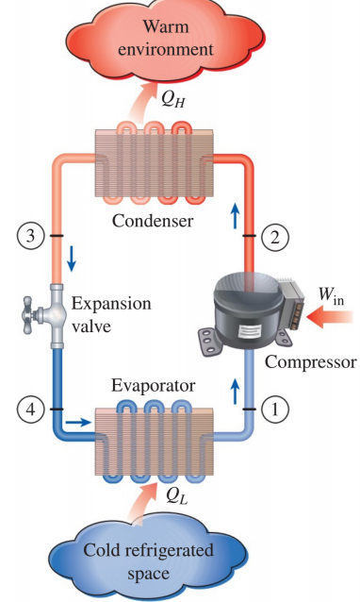
Vapor Compression Cycle
Most common refrigeration cycle around the world
Rest of presentation is about the vapor compression cycle!

Slide 4
Given
Info.
Let’s consider a vapor compression cycle using R-134a as a refrigerant with a mass flow of 0.1 kg/s and runs between pressures of 0.14 MPa and 1.2 MPa. State 1 is a saturated vapor, and State 3 is a saturated liquid.

Slide 5
Question 1
Provide a description of what happens to the refrigerant fluid as it flows through the cycle. Include real-life pictures of what the component looks like whenever possible (Look at your own fridge, or if not convenient, use the Internet). Using past examples as reference, how would you model each of the 4 processes (what property remains constant, is there heat transfer or work being exchanged?)

Slide 6
Question 1
Mass flow = 0.1 kg/s
P_{low}= 0.14 MPa x₁ = 1
P_{high}= 1.2 MPa x₃ = 0
Description of what occurs;
System is the cycle:
R-134a goes through compressor, becomes superheated vapor that is hotter than “warm environment” due to electrical work coming in from the surroundings
R-134a rejects heat through the condenser so that heat leaves the system of the cycle
R-134a enters the expansion valve where it cools down into a 2-phase mixture
R-134a takes in heat from the cold refrigerated space and the cycle starts again
Plan: Use First Law on 1→2, 2→3, 3→4, and 4→1
Notes:
The R-134a is in State 1. It is in the saturated vapor state at the minimum pressure of 0.14 MPa and is also therefore at -18.80℃, which is the corresponding saturated temperature at 0.14 MPa. This vapor travels towards the compressor where it gains energy from the in the form of electrical work which actuates the piston, making the temperature R-134a increase to a value that is hotter than the temperature of the warm outside environment.
The R-134a is in State 2 now. The only known properties of the R-134a is that it is at the maximum possible pressure (1.2 MPa) and in a superheated vapor state. This vapor travels to the condenser where the R-134a is at a higher temperature than the warm outside environment and therefore loses energy in the form of heat to the outside environment, removing it from the system. This happens as empirically observed by the Clausius Statement because heat only travels naturally from the hotter reservoir to the colder reservoir. This process also happens at constant pressure and is therefore modelled as isobaric.
The R-134a is in State 3 now. It is in the saturated liquid state at the maximum pressure of 1.2 MPa and is also therefore at 46.32℃, which is the corresponding saturated temperature at 1.2 MPa, just slightly cooler than the temperature of State 2. This liquid travels towards the expansion valve where the R-134a is able to expand without heat or work transfers. Therefore, there is no change in specific enthalpy. This expansion of the R-134a—corresponding to a drop in pressure as well—allows it to cool down to a temperature that is lower than the temperature inside the cold refrigerated space (inside the fridge).
The R-134a is in State 4 now. The only known property of the R-134a is that it is in the two-phase mixture state. The R-134a enters into the evaporator and comes out at a temperature of -18.80℃ corresponding to property tables for the minimum possible pressure (0.14 MPa). The temperature that the R-134a entered the evaporator with is much lower than that of the fridge’s contents, therefore heat is transferred from the inside of the fridge and into the evaporator in accordance with the Clausius statement. This causes the R-134a to isothermally change phase from two-phase to saturated vapor.
The R-134a is at State 1 now and the cycle repeats.

Slide 7
Question 1
Mass flow = 0.1 kg/s
P_{low}= 0.14 MPa x₁ = 1
P_{high}= 1.2 MPa x₃ = 0
From 1→2:
R-134a goes through compressor!
Saturated vapor to superheated vapor (we find out it is superheated vapor from Question 2!)
Initial Modelling Assumptions:
Compressor is adiabatic (no heat transfer)
Compressor is in steady state
Compressor does not significantly change R-134a’s kinetic or potential energy

Slide 8
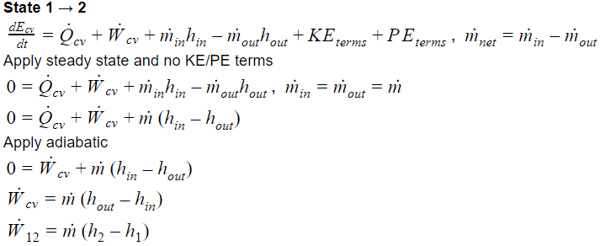
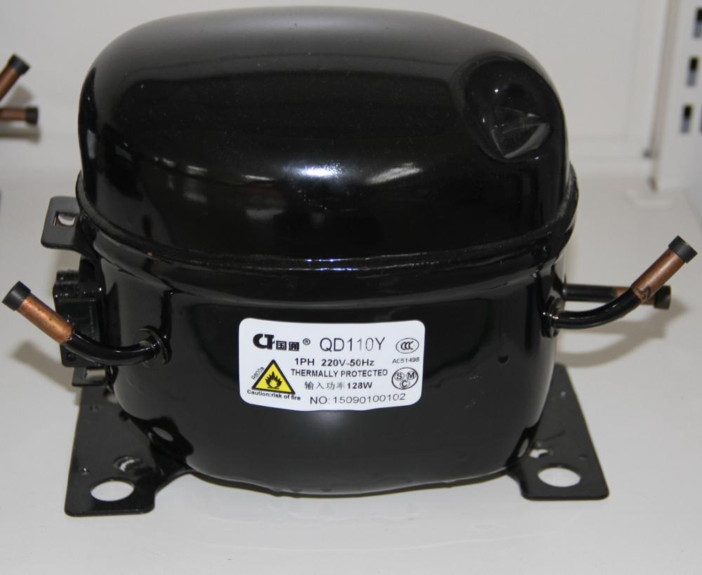
Question 1
Mass flow = 0.1 kg/s
P_{low}= 0.14 MPa x₁ = 1
P_{high}= 1.2 MPa x₃ = 0
Compressor
Image Source: https://sc01.alicdn.com/kf/HTB10W8ivcyYBuNkSnfoq6AWgVXan.jpg

Slide 9
Question 1
Mass flow = 0.1 kg/s
P_{low}= 0.14 MPa x₁ = 1
P_{high}= 1.2 MPa x₃ = 0
From 2→3:
R-134a goes through condenser!
Superheated vapor to saturated liquid
Initial Modelling Assumptions:
Model as heat exchanger, which means no change in pressure
Condenser has no work transfers
Condenser is in steady state
Condenser does not significantly change R-134a’s kinetic or potential energy

Slide 10
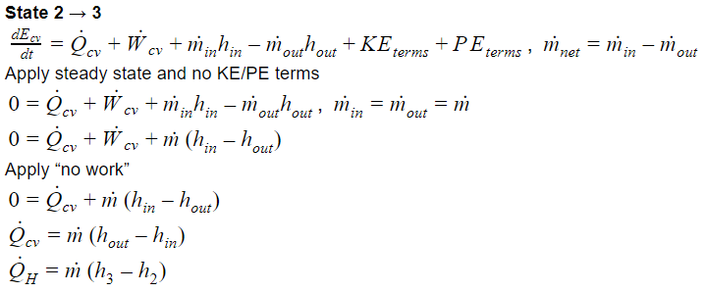
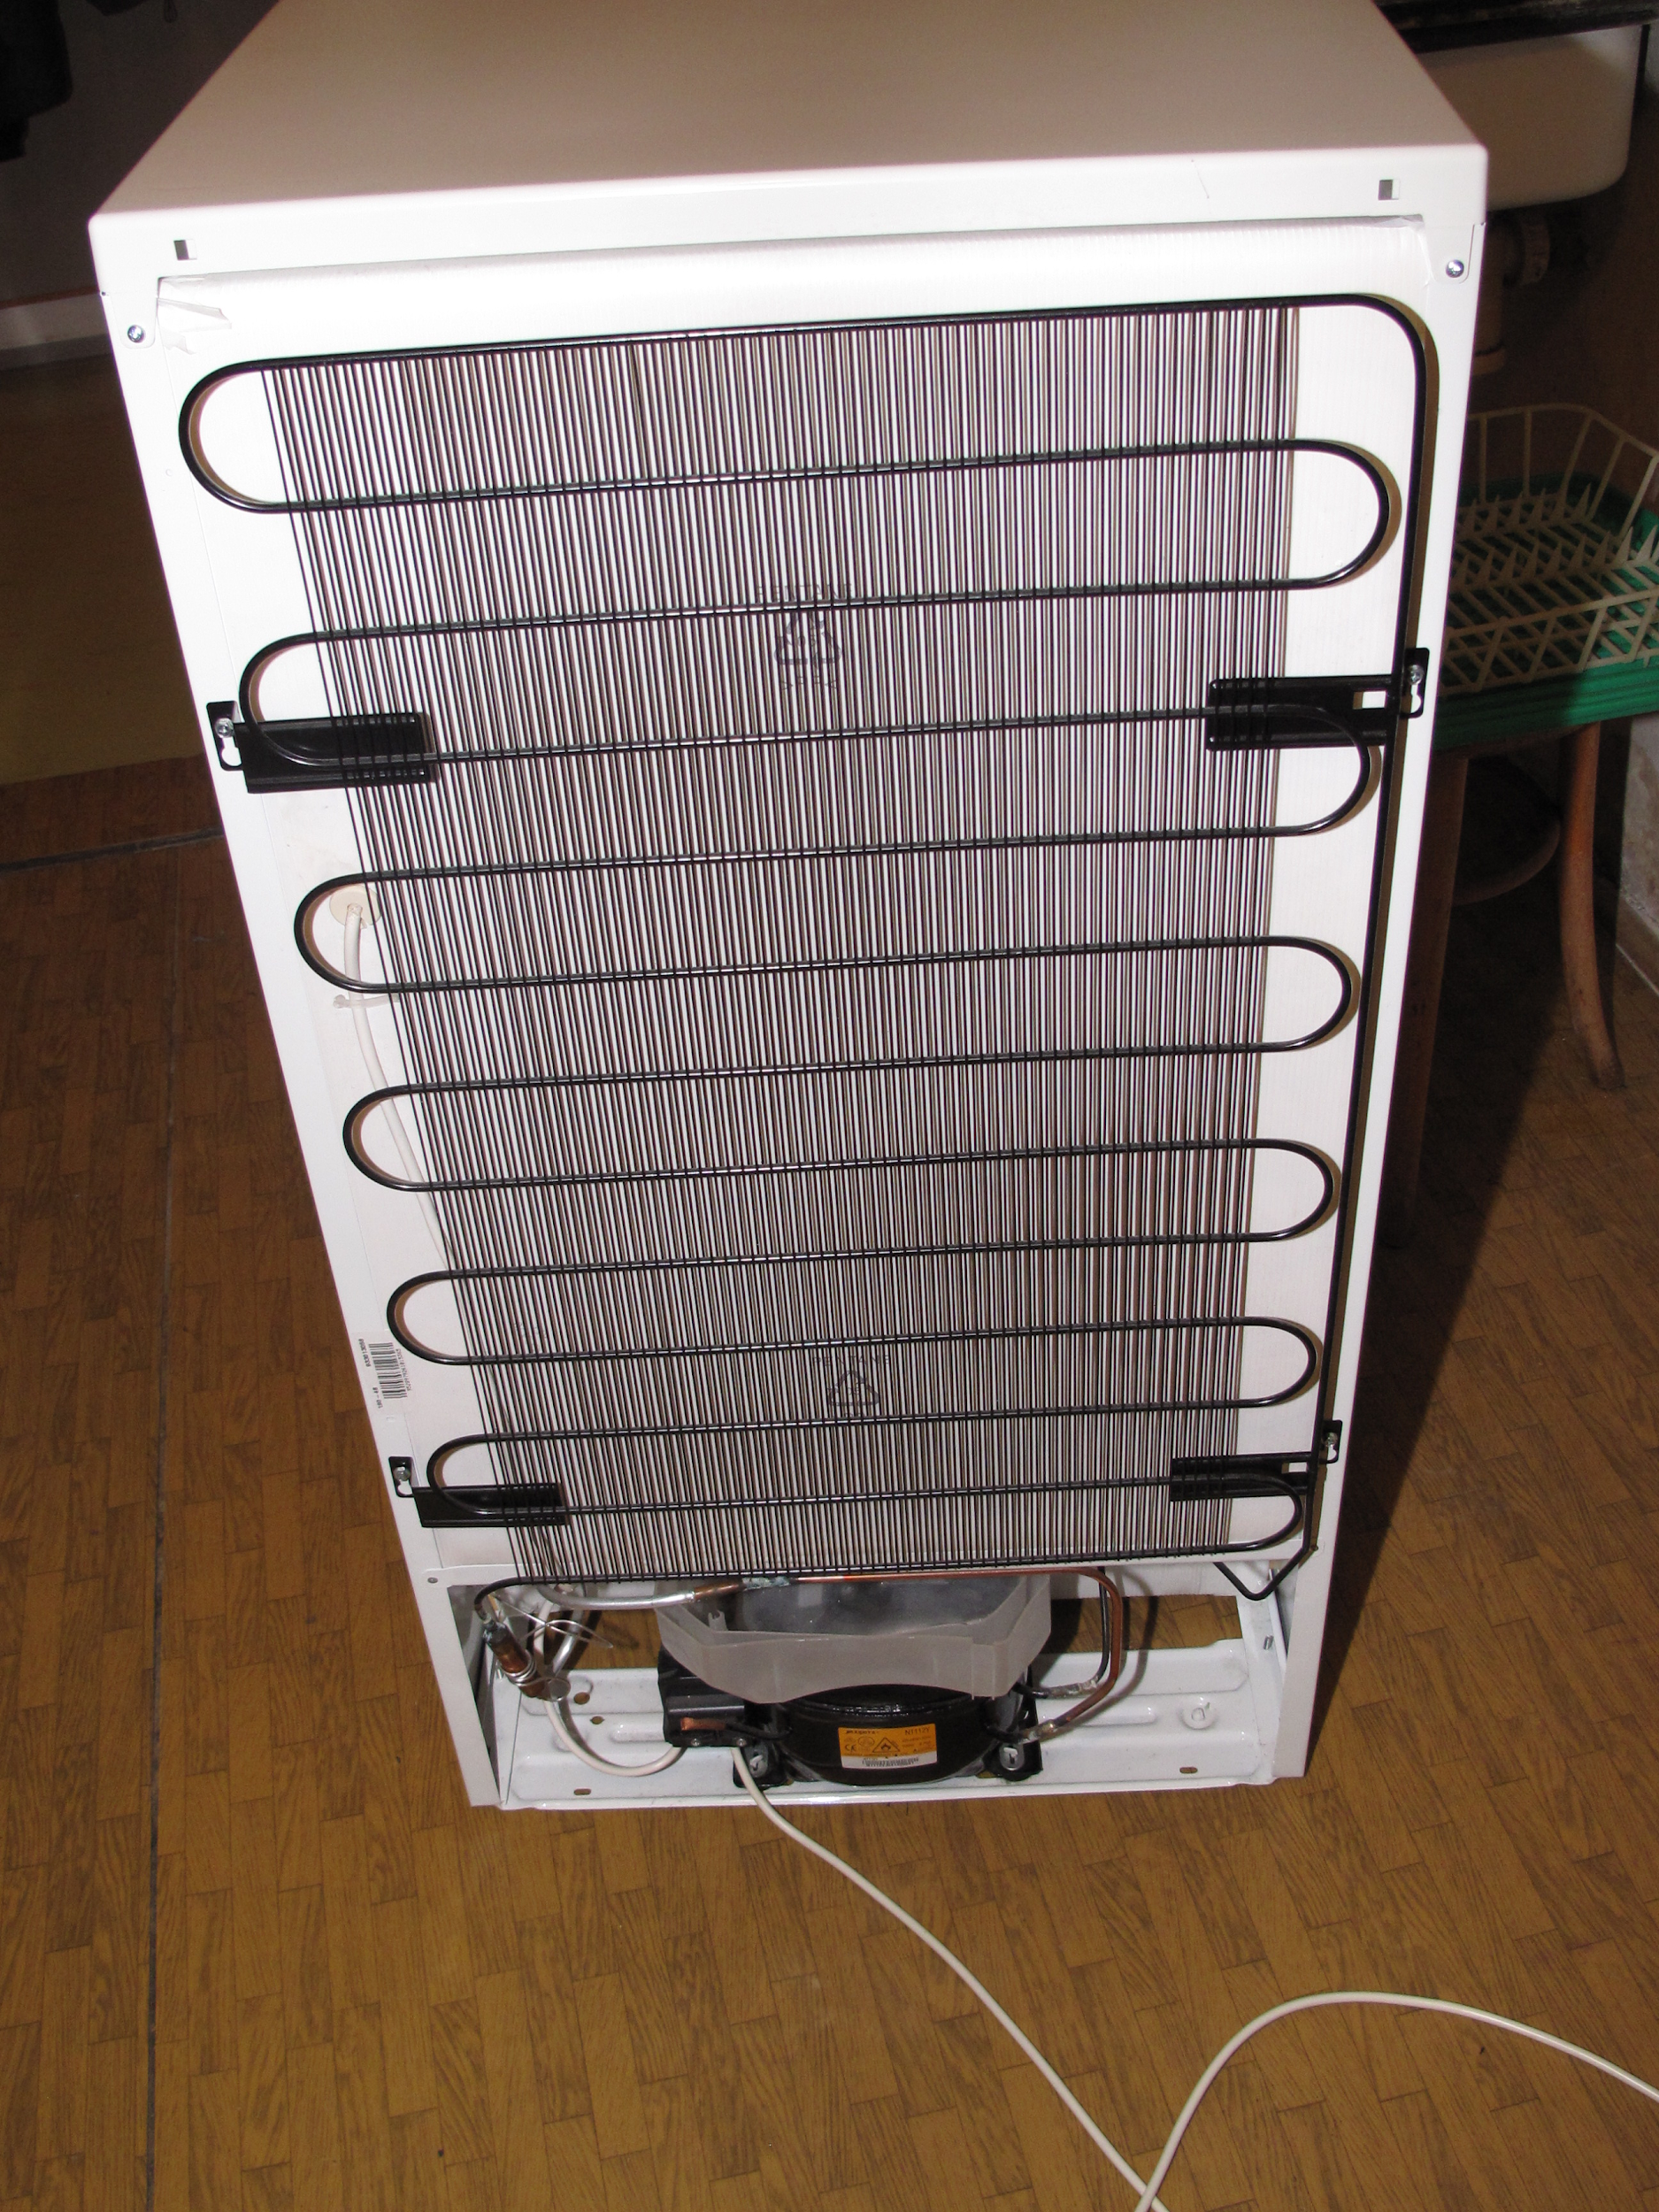
Question 1
Mass flow = 0.1 kg/s
P_{low}= 0.14 MPa x₁ = 1
P_{high}= 1.2 MPa x₃ = 0
Condenser
Image Source: https://en.wikipedia.org/wiki/Condenser_(heat_transfer)

Slide 11
Question 1
Mass flow = 0.1 kg/s
P_{low}= 0.14 MPa x₁ = 1
P_{high}= 1.2 MPa x₃ = 0
From 3→4:
R-134a goes through expansion valve!
Saturated liquid to 2-phase (we find out it is 2-phase from Question 2!)
Initial Modelling Assumptions:
Expansion valve does no work
Expansion valve is adiabatic (no heat transfer)
Expansion valve is in steady state
Expansion valve does not significantly change R-134a’s kinetic or potential energy

Slide 12
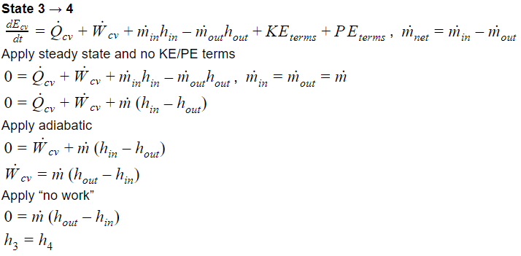
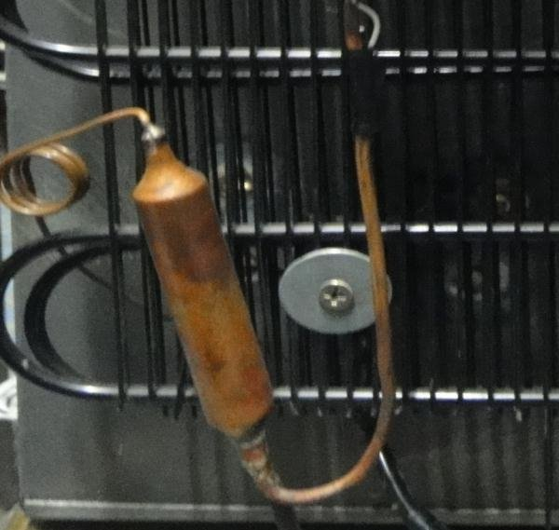
Question 1
Mass flow = 0.1 kg/s
P_{low}= 0.14 MPa x₁ = 1
P_{high}= 1.2 MPa x₃ = 0
Expansion Valve
Image Source: https://www.researchgate.net/figure/Filter-fitted-with-an-Expansion-valve_fig2_271257314

Slide 13
Question 1
Mass flow = 0.1 kg/s
P_{low}= 0.14 MPa x₁ = 1
P_{high}= 1.2 MPa x₃ = 0
From 4→1:
R-134a goes through condenser!
2-phase to saturated vapor
Initial Modelling Assumptions:
Model as heat exchanger, which means no change in pressure
Evaporator has no work transfers
Evaporator is in steady state
Evaporator does not significantly change R-134a’s kinetic or potential energy

Slide 14
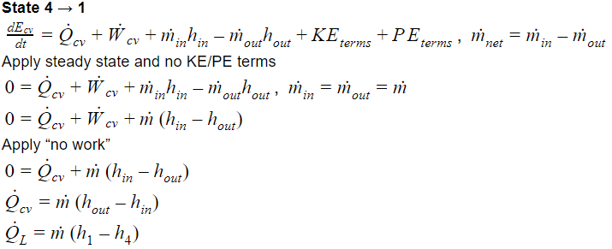
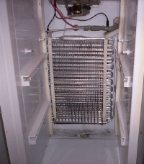
Question 1
Mass flow = 0.1 kg/s
P_{low}= 0.14 MPa x₁ = 1
P_{high}= 1.2 MPa x₃ = 0
Evaporator
Image Source: https://www.fridgefilters.com/fridgepedia-refrigerator-evaporator.html

Slide 15
Question 1
Mass flow = 0.1 kg/s
P_{low}= 0.14 MPa x₁ = 1
P_{high}= 1.2 MPa x₃ = 0
State 1:
P₁ = 0.14MPa because the heat exchangers do not change pressure, so must be at lower pressure
T₁ = -18.80℃ (from table; State 1 is sat. vapor)
s₁ = 0.9322 kJ/kg.K (sat. vapor)
State 2:
P₂ = 1.2MPa
T₂ = ?
s₂ = ?
State 3:
P₃ = 1.2MPa
T₃ = 46.32℃ (from table; State 3 is sat. liquid)
s₃ = 0.4164 kJ/kg.K (sat. liquid)
State 4:
P₂ = 0.14MPa
T₄ = -18.80℃ (because 2-phase, constant pressure)
s₄ = ?

Slide 16
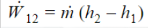
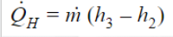
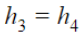
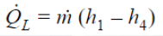
Question 1
Mass flow = 0.1 kg/s
P_{low}= 0.14 MPa x₁ = 1
P_{high}= 1.2 MPa x₃ = 0
Summary:
1→2:
State 2:
P₂ = 1.2MPa
T₂ = ?
s₂ = ?
State 1:
P₁ = 0.14MPa
T₁ = -18.80℃
s₁ = 0.9322 kJ/kg.K
2→3:
3→4:
State 3:
P₃ = 1.2MPa
T₃ = 46.32℃
s₃ = 0.4164 kJ/kg.K
State 4:
P₂ = 0.14MPa
T₄ = -18.80℃
s₄ = ?
4→1:

Slide 17
Question 2
Assuming that all components in the cycle that can be ideal are ideal, draw the T − s diagram for that cycle. Indicate on each segment of the cycle whether heat or work is being exchanged between the working fluid and its surrounding.

Slide 18
Question 2
The expansion valve cannot be isentropic because of free gas expansion!
State 1 → State 2
No heat exchanges, work is being added to working fluid from surroundings
State 2 → State 3
Heat is being added to the surroundings from the working fluid, no work exchanges
State 3 → State 4
No heat exchanges, no work exchanges
State 4 → State 1
Heat is being added to the working fluid from the surroundings, no work exchanges

Slide 19
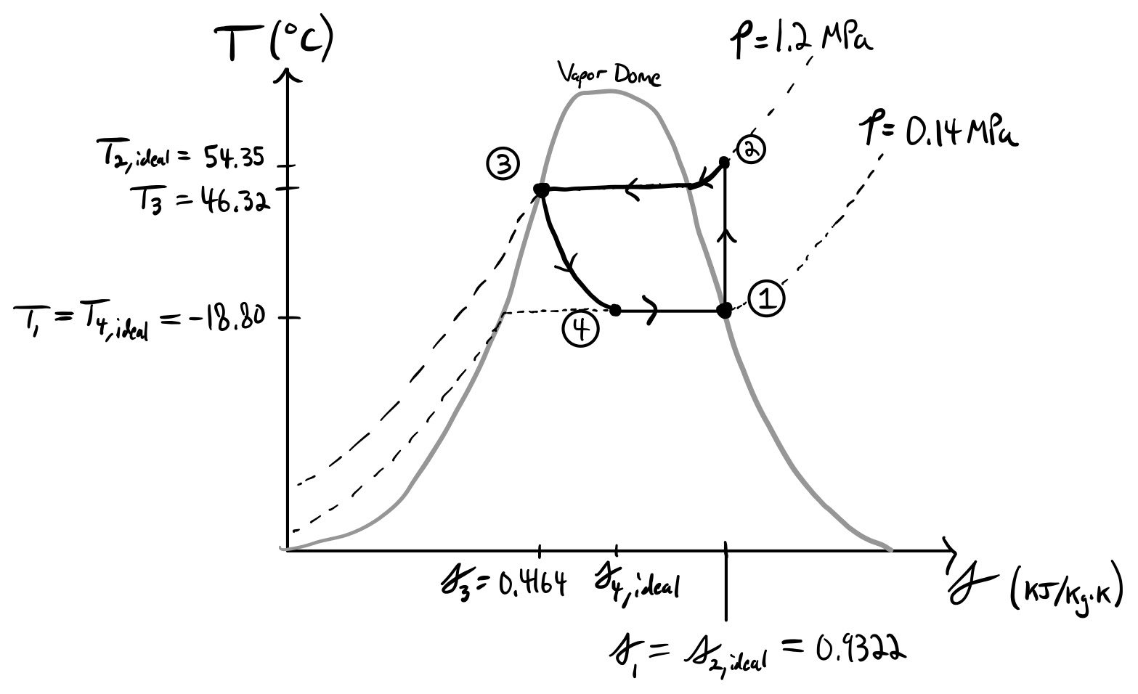
*
System: R-134a
1→2: Q = 0, W > 0
2→3: Q < 0, W = 0
3→4: Q = 0, W = 0
4→1: Q > 0, W = 0
Found/calculated later on.
Notes:
Process 1 → 2 is isentropic therefore s1=s2,ideal (straight line up);
Process 2 → 3 is *isobaric* heat loss therefore temperature decreases along the P = 1.2 MPa contour until reaching sat. liquid line;
Process 3 → 4 is isenthalpic expansion, however it is not isentropic because of the nature of free expansion, pressure decreases back to
0.14 Mpa as a result. Since steady state & sigma > 0 & Q = 0, s4,ideal > s3 by entropy balance equation
Process 4 → 1 Is isobaric heat addition up to saturated vapor (state 1), therefore follows a constant line (because inside vapor dome)
Cycle Repeats.

Slide 20
Question 3
How does the T − s diagram change if we can no longer assume the compressor and the expansion valve to be ideal?

Slide 21
Question 3
Heat Exchangers would remain the same
Compressor would not be isentropic; entropy would increase and T-s diagram from 1→2 is no longer vertical
Expansion valve would have greater increase in entropy and so the process line would have more “horizontal” to it

Slide 22
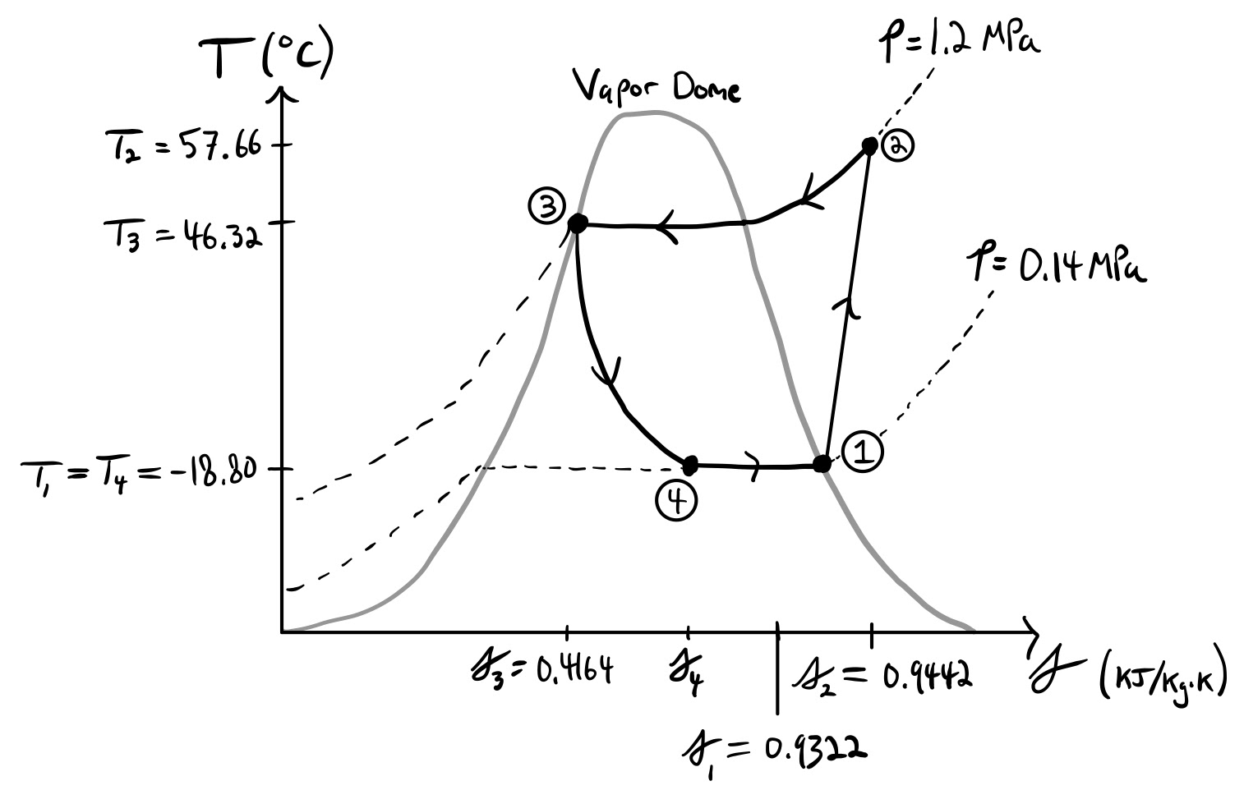
*
*
Found/calculated later on.
Notes:
Process 1 → 2 is NOT isentropic anymore, but because its steady state & Q = 0 & sigma > 0,
then therefore s2 > s1 by the entropy balance equation; Pressure increases to P = 1.2 MPa because of the compression
Process 3 → 4 slightly more entropy due to process no longer being isenthalpic

Slide 23
Question 4
Assume that the valve is still ideal, but the compressor has an isentropic efficiency of 92%. What is the power required to run this cycle? How much heat is extracted from the cold space?

Slide 24
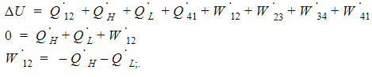
Question 4
Analyze using First Law for the entire cycle:
Recall that
We know h₁ because State 1 is sat. vapor, need h₂
Plan:
Find s_{2, ideal} to get h_{2, ideal}
Use η = 0.92 and inefficiency equation to get h_{2, real}
Plug in values into W₁₂ equation

Slide 25
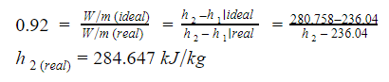
Question 4
S₂ (ideal) = s₁ = 0.9233
We find h_{2 (ideal)} by interpolation in the superheated tables
h₂(ideal) = 280.758kJ/kg
We use h_{2real} to find s_{2(real)} and T₂ with interpolation
Plugging in h_{2(real)} and h₁ into the W₁₂ equation:

Slide 26
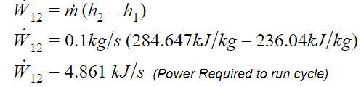
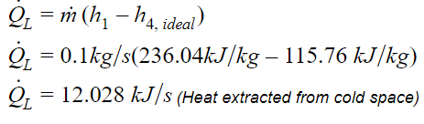
Question 4
Recall h₃ = h₄
We found h₃ in the saturated tables

Slide 27
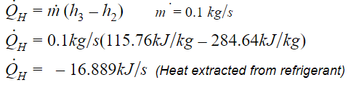
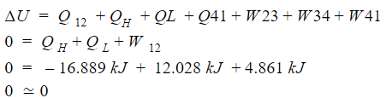
Question 4
Calculate for Q_{H} to plug into First law equation:
\
To check our work we use the First Law:
Everything checks out!

Slide 28
Question 5
What is the coefficient of performance of the cycle? How does this compare to the Carnot (fully reversible) COP? What would the corresponding Carnot cycle operating between the same temperature look like in a T − s diagram? What practical difficulties would we face if we were trying to reproduce the Carnot cycle?

Slide 29
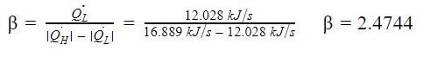
Question 5
For a fully reversible cycle
Everything is the same in previously solved ideal case EXCEPT the expansion valve is now isentropic
Previously assumed all devices except valve was isentropic
To calculate the fully reversible coefficient of performance:
Recall
Fully reversible valve means h₄ changes
Need to recalculate h₄ to get new Q_{L}
Use new Q_{L} to calculate new ꞵ for fully reversible cycle

Slide 30
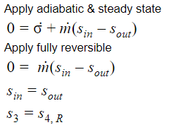
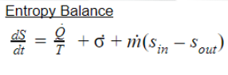
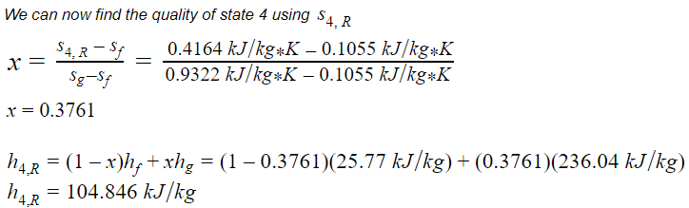
Question 5

Slide 31
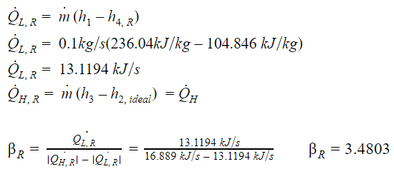
Question 5
(Q_{H} is the same as before)
As we can see, the fully reversible coefficient of performance is higher than the one for the non-reversible expansion valve!

Slide 32
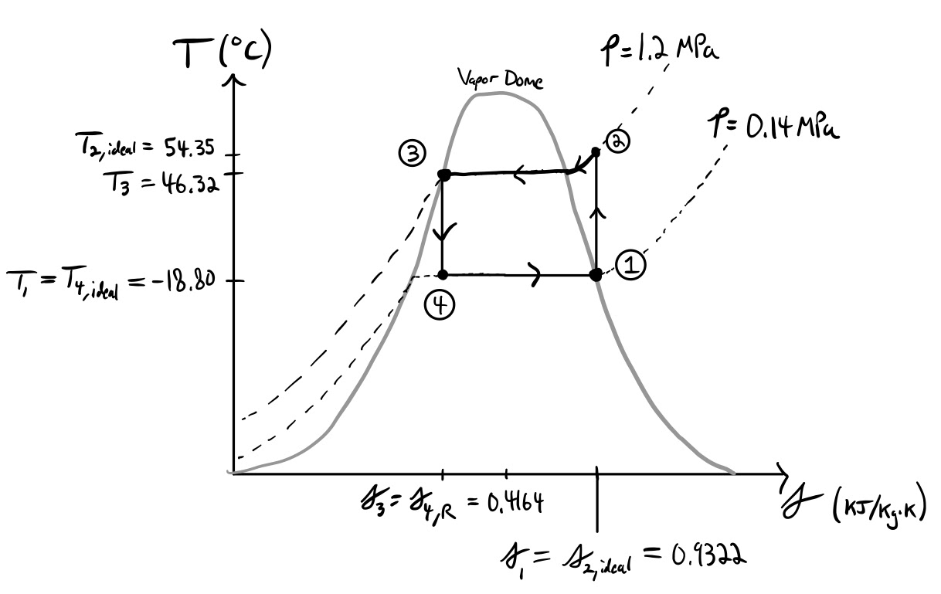
For a Carnot cycle operating between the SAME TEMPERATURES as before!
Notes:
As we can see, the diagram is the exact same as in the ideal scenario for question 2, however now the valve (i.e. process 3 → 4) is reversible therefore isentropic (straight line down)

Slide 33
Question 5
Difficulty of reproducing the Carnot cycle:
Expansion valve allows for free expansion of gas
Free expansion necessitates internal irreversibilities
Makes sense, when gas freely expands, it would make no sense in reverse!
While we could recompact the gas by putting in work, surroundings would not be at the same state as before
Therefore fundamentally an irreversible process
Because of above, Carnot cycle for expansion valve has zero probability of occuring in nature
Tough practical difficulty to get around!

Slide 34
Question 6
In an attempt to extract some work out of the cycle, you replace the throttle with a little turbine. Assuming the turbine is ideal and the pressure ratio across the turbine is the same as that of the throttle, how much work could you extract from the fluid? How does this change the heat extracted from the cold space assuming that State 1 is the same?

Slide 35
Question 6
State properties for States 1, 2, and 3 remain the same because:
Their derivations do not involve device properties from 3→4
Pressure ratio across device is the same
W₁₂ and Q_{H} are unchanged for the same reasons
Plan:
Use the 1st Law on the new turbine & the evaporator
Need to calculate h_{4, ideal}
Isentropic turbine & same pressures → use P & s to get quality
Use quality (x) to get h_{4, ideal}
Plug back into 1st law to get W₃₄ , & Q_{L}

Slide 36
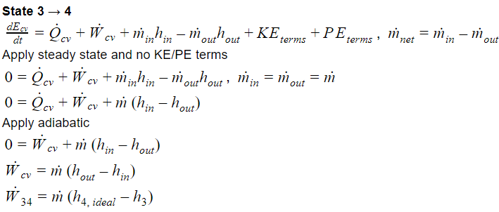
Question 6

Slide 37
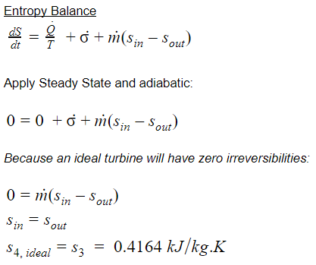
Question 6

Slide 38
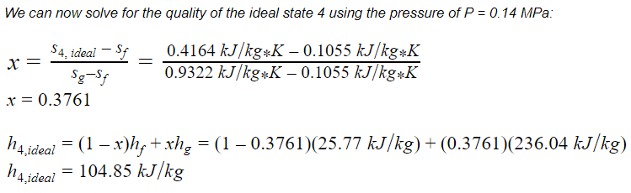
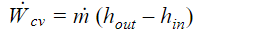
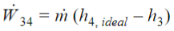
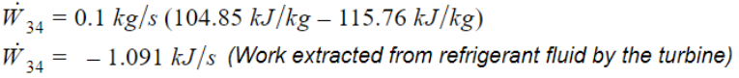
Question 6

Slide 39
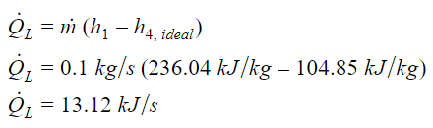
Question 6
Using the same equation derived in Question 4, and plugging in our new value for h4, ideal we get a new value for the heat extracted from the cold space:
Originally without the turbine Q_{L}= 12.028 kJ/s
Therefore more heat is now being extracted from the cold space, by approximately the same amount of energy that is extracted as work by the turbine such that the 1st law for the entire cycle is still obeyed.

Slide 40
Questions?
Comments?
Concerns?

